Slide 1
A beginner’s guide to Data Analytics: Intro to Classification Strategies
Damian A. Tamburri, Ph.D.

Slide 2
Recap from last episodes…
Stuff about projects…
NOTE: get going! Time is a luxury you do *not* have!
What is AI and what is Machine-Learning
The CRISP-DM model and ML canvas
Precision/Recall & F-Measure

Slide 3
Now What?
What does it really mean for a Machine to “Learn”?
What can be learned?
How does the machine “learn”?
What does it mean?
...

Slide 4
Let’s go by Example... Text Classification
Classified text files
Text file 1 trade
Text file 2 ship
… …
Training
Human Text classifier
New text file
class

Slide 5
Let’s go by Example... Disease Classification
Database of medical records
Patient 1’s data Absence
Patient 2’s data Presence
… …
Training
Human Disease classifier
New patient’s data
Presence or absence

Slide 6
Let’s go by Example... Move Classification
Games played:
Game 1’s move list Win
Game 2’s move list Lose
… …
Training
New matrix representing the current board
Strategist of Moves Search and Evaluation
Best move

Slide 7
Machine learning problems
(at least) 3 classes of problems
Supervised Learning
Unsupervised Learning
Reinforcement Learning

Slide 8
Machine learning problems
(at least) 3 classes of problems:
Supervised Learning
Unsupervised Learning
Reinforcement Learning
What’s the difference?

Slide 9
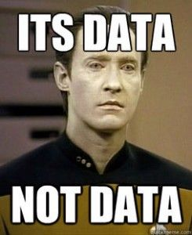
Machine learning problems
(at least) 3 classes of problems:
Supervised Learning
Unsupervised Learning
Reinforcement Learning
What’s the difference?
DATA!

Slide 10

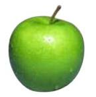

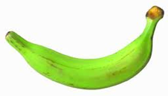
Data
examples
Data

Slide 11

Data
examples
Data

Slide 12
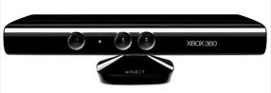
Data
examples
Data

Slide 13

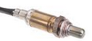
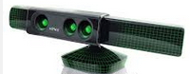
Data
examples
Data

Slide 14
Supervised learning
examples
label
label₁
label₃
labeled examples
label₄
label₅
Supervised learning: given labeled examples

Slide 15
Supervised learning
label
label₁
model/
predictor
label₃
label₄
label₅
Supervised learning: given labeled examples

Slide 16
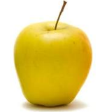
Supervised learning
model/
predictor
predicted label
Supervised learning: learn to predict new example

Slide 17
Supervised learning: classification
label
apple
Classification: a finite set of labels
apple
banana
banana
Supervised learning: given labeled examples

Slide 18
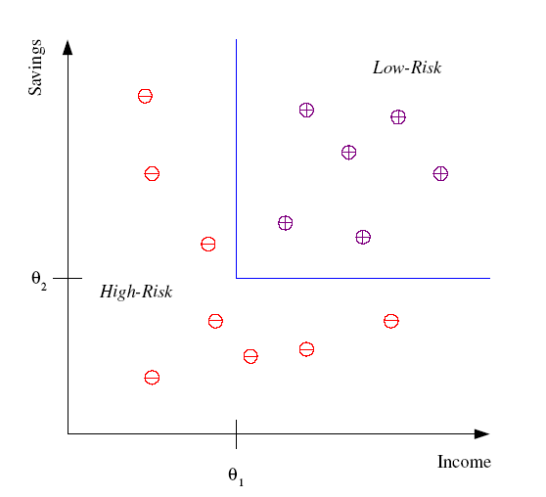
Classification Example
Differentiate between low-risk and high-risk customers from their income and savings

Slide 19
Supervised learning: regression
label
-4.5
Regression: label is real-valued
10.1
3.2
4.3
…
Supervised learning: given labeled examples

Slide 20
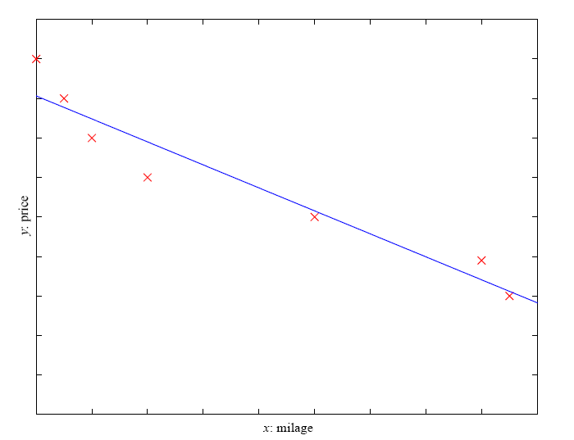
Regression Example
Price of a used car
x : car attributes (e.g. mileage)
y : price
y = wx+w₀

Slide 21
Regression Applications
Economics/Finance: predict the value of a stock
Epidemiology
Car/plane navigation: angle of the steering wheel, acceleration, …
Temporal trends: weather over time
…

Slide 22
Supervised learning: ranking
label
1
Ranking: label is a ranking (something that can be reduced to Ν)
4
2
3
Supervised learning: given labeled examples

Slide 23
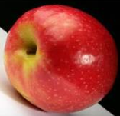
Unsupervised learning
Unupervised learning: given data, i.e. examples, but no labels

Slide 24
Unsupervised learning applications
learn clusters/groups without any label
customer segmentation (i.e. grouping)
image compression
bioinformatics: learn motifs
…

Slide 25
Reinforcement learning
left, right, straight, left, left, left, straight
GOOD
left, straight, straight, left, right, straight, straight
BAD
left, right, straight, left, left, left, straight
18.5
left, straight, straight, left, right, straight, straight
-3
Given a sequence of examples/states and a reward after completing that sequence, learn to predict the action to take in for an individual example/state

Slide 26
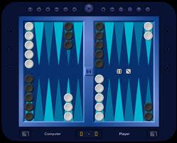
Reinforcement learning example
Backgammon
…
WIN!
…
LOSE!
Given sequences of moves and whether or not the player won at the end, learn to make good moves

Slide 27

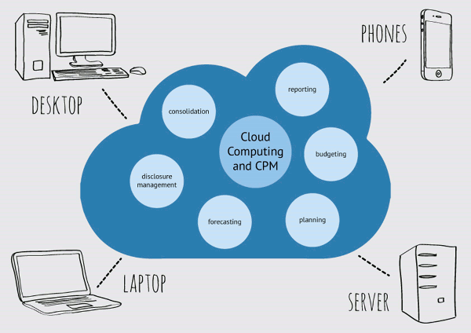
Why Is Machine Learning Possible?
Mass Storage
More data available
Internet! Data is Everywhere!
Big Data!
Higher Performance of Computers & Clouds;
Larger memory in handling the data;
Greater computational power for calculating
Online continuous learning;

Slide 28
Other learning variations
What data is available:
Supervised, unsupervised, reinforcement learning
semi-supervised, active learning, transfer learning…
How are we getting the data:
online vs. offline learning
Type of model:
generative vs. discriminative
parametric vs. non-parametric
…
Notes:
Transfer learning is a machine learning method where a model developed for a task is reused as the starting point for a model on a second task.

Slide 29
Now, back to our Turf: Machine learning problems!
(at least) 3 classes of problems
Supervised Learning
Unsupervised Learning
Reinforcement Learning

Slide 30
Definition
Supervised Learning. «the task of learning a function that maps an input to an output based on sample input-output pairs» [1]
[1] Stuart J. Russell, Peter Norvig (2010) Artificial Intelligence: A Modern Approach, Third Edition, Prentice Hall ISBN 9780136042594.
Notes:
It infers a function from labeled training data consisting of a set of training examples

Slide 31
Definition
Supervised Learning. «the task of learning a function that maps an input to an output based on sample input-output pairs» [1]
Labels.
Real numbers ==> Regression
Discrete numbers of classes ==> Classification
[1] Stuart J. Russell, Peter Norvig (2010) Artificial Intelligence: A Modern Approach, Third Edition, Prentice Hall ISBN 9780136042594.
Notes:
It infers a function from labeled training data consisting of a set of training examples

Slide 32

Supervision ➔ Labels

Slide 33
Microsoft considers another one*
Anomaly detection. Sometimes the goal is to identify data points that are simply unusual (e.g., fraud detection)
The approach that anomaly detection takes is to simply learn what normal activity looks like and identify anything that is significantly different.
* https://docs.microsoft.com/en-us/azure/machine-learning/studio/algorithm-choice

Slide 34
For example, Classifiers: Nearest neighbor
Test example
Training examples from class 2
Training examples from class 1
f(x) = label of the training example nearest to x
All we need is a distance function for our inputs
No training required!
Slide credit: L. Lazebnik

Slide 35
Classifiers: Linear
Find a linear function to separate the classes:
f(x) = sgn(w ⋅ x + b)
Slide credit: L. Lazebnik

Slide 36
Many classifiers to choose from
SVM
Neural networks
Naïve Bayes
Bayesian network
Logistic regression
Randomized Forests
Boosted Decision Trees
K-Nearest Neighbor
RBMs
Etc.
BI question: Which is the best one?
Slide credit: D. Hoiem

Slide 37
Many classifiers to choose from
SVM
Neural networks
Naïve Bayes
Bayesian network
Logistic regression
Randomized Forests
Boosted Decision Trees
K-Nearest Neighbor
RBMs
Etc.
There isn’t...
Slide credit: D. Hoiem

Slide 38
Many classifiers to choose from
SVM
Neural networks
Naïve Bayes
Bayesian network
Logistic regression
Randomized Forests
Boosted Decision Trees
K-Nearest Neighbor
RBMs
Etc.
You’ll find one through
experimentation!
Slide credit: D. Hoiem

Slide 39
Now, back to our Turf: Machine learning problems!
(at least) 3 classes of problems
Supervised Learning
Unsupervised Learning
Reinforcement Learning

Slide 40
Definition
Unsupervised Learning. «task of inferring a function that describes the structure of "unlabeled" data»
Notes:
Since the examples given to the learning algorithm are unlabeled, there is no straightforward way to evaluate the accuracy of the structure that is produced by the algorithm—one feature that distinguishes unsupervised learning from supervised learning and reinforcement learning.
A central application of unsupervised learning is in the field of density estimation in statistics,^{[1]} though unsupervised learning encompasses many other problems (and solutions) involving summarizing and explaining various key features of data.

Slide 41
Why Unsupervised?
*No* labels
Goal is to organize the data in some way or to describe its structure
Grouping data into clusters;
Finding different ways of looking at complex data;
Make data simpler;
More organized for further processing;

Slide 42
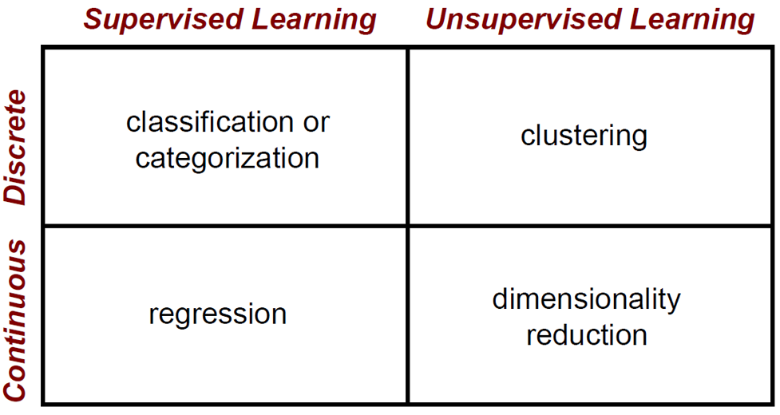
ML Strategies

Slide 43
Clustering Strategies
K-means
Iteratively re-assign points to the nearest cluster center
Agglomerative clustering
Start with each point as its own cluster and iteratively merge the closest clusters
Mean-shift clustering
Imagine points would climb to nearest peak
Spectral clustering
Split the nodes in a graph based on assigned links with similarity weights
Tendency towards a single cluster!
Notes:
As we go down this chart, the clustering strategies have more tendency to transitively group points even if they are not nearby in feature space

Slide 44
Clustering Strategies
K-means
Iteratively re-assign points to the nearest cluster center
Agglomerative clustering
Start with each point as its own cluster and iteratively merge the closest clusters
Mean-shift clustering
Imagine points would climb to nearest peak
Spectral clustering
Split the nodes in a graph based on assigned links with similarity weights
Tendency towards a single cluster!
Notes:
As we go down this chart, the clustering strategies have more tendency to transitively group points even if they are not nearby in feature space

Slide 45
K-Means Explained
vector quantization*, by partitioning of N observations into K clusters - each observation belongs to the cluster with the nearest mean, serving as a prototype of the cluster.
*originally from signal processing

Slide 46
K-means Algorithm
Given the cluster number K, the K-means algorithm is carried out in three steps after initialisation:
Initialisation: set seed points (randomly)
Assign each object to the cluster of the nearest seed point measured with a specific distance metric
Compute new seed points as the centroids of the clusters of the current partition (the centroid is the centre, i.e., mean point, of the cluster)
Go back to Step 1), stop when no more new assignment (i.e., membership in each cluster no longer changes)

Slide 47
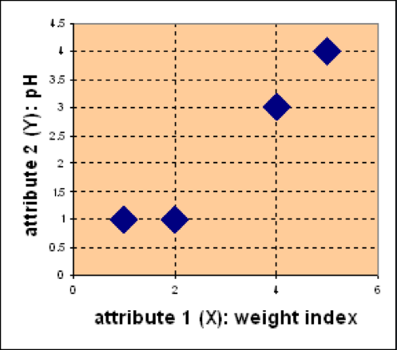
Example
Problem
Suppose we have 4 types of medicines and each has two attributes (pH and
weight index). Our goal is to group these objects into K=2 group of medicine.
D
Medicine | Weight | pH-Index
A | 1 | 1
B | 2 | 1
C | 4 | 3
D | 5 | 4
C
A
B

Slide 48
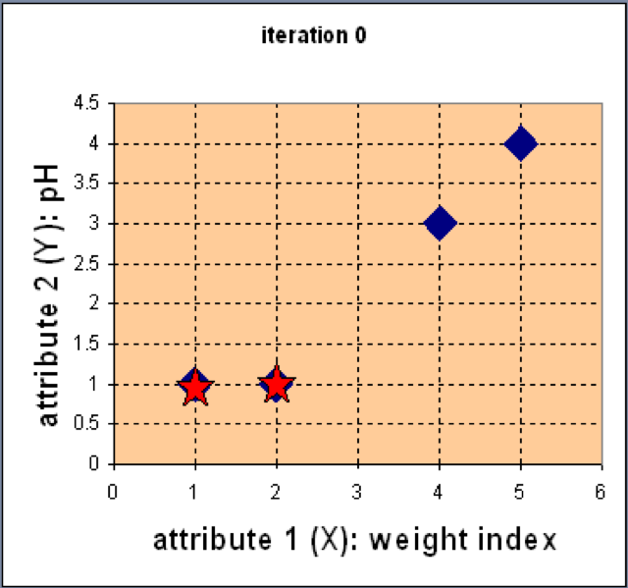
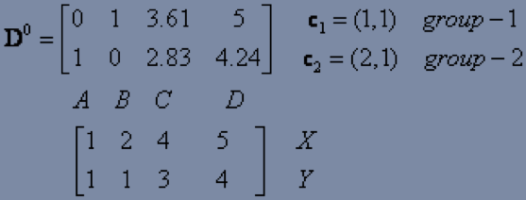
Example
Step 1: Use initial seed points for partitioning
D
C
Euclidean distance
A
B
Assign each object to the cluster
with the nearest seed point

Slide 49
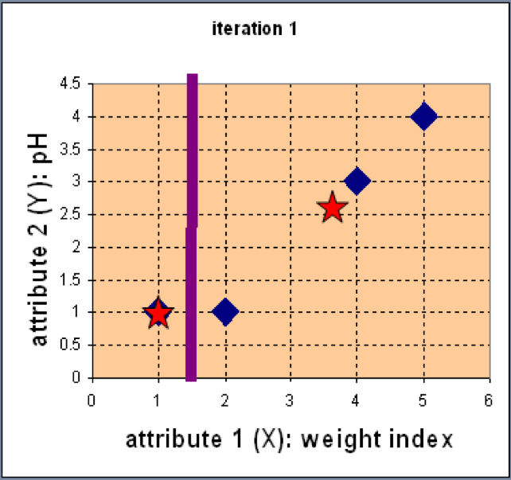
Example
Step 2: Compute new centroids of the current partition
Knowing the members of each
cluster, now we compute the new
centroid of each group based on
these new memberships.
Notes:
(the centroid is the centre, i.e., mean point, of the cluster)

Slide 50
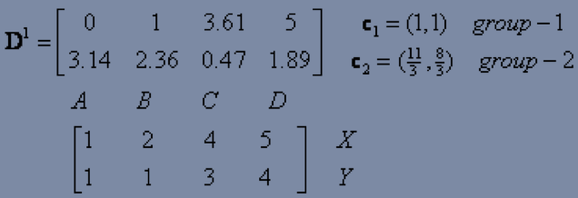
Example
Step 2: Renew membership based on new centroids
Compute the distance of all objects to the new centroids
Assign the membership to objects

Slide 51
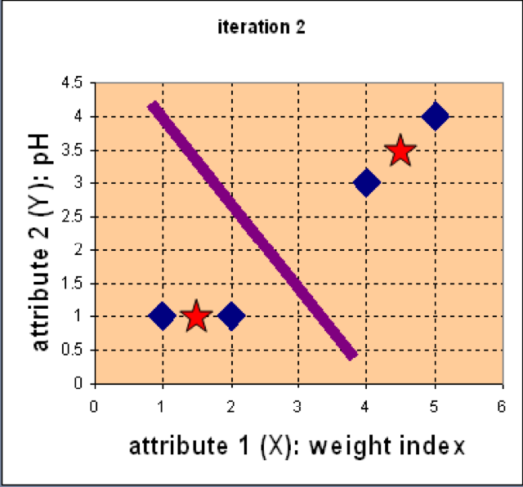
Example
Step 3: Repeat the first two steps until its convergence
Knowing the members of each
cluster, now we compute the new
centroid of each group based on
these new memberships.

Slide 52
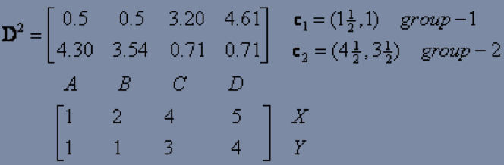
Example
Step 3: Repeat the first two steps until its convergence
Compute the distance of all objects to the new centroids
Stop due to no new assignment
Membership in each cluster no longer change

Slide 53
Now, back to our Turf: Machine learning problems!
(at least) 3 classes of problems
Supervised Learning
Unsupervised Learning
Reinforcement Learning

Slide 54
Definition
Reinforcement Learning. «the task of learning how software agents ought to take actions in an environment so as to maximize some notion of cumulative reward.»

Slide 55
Why Reinforcement?
Algorithm gets to choose an action in response to each data point;
Reward signal a short time later, indicating how good the decision was;
Build a strategy – the algo modifies its strategy in order to achieve the highest reward;
Reinforcement learning is common in robotics, where the set of sensor readings at one point in time is a data point, and the algorithm must choose the robot's next action. It is also a natural fit for Internet of Things (IoT) applications.
Notes:
https://docs.microsoft.com/en-us/azure/machine-learning/studio/algorithm-choice

Slide 56
For example: Robot in a room
 |  |  | +1
 |  |  | -1
START
actions: UP, DOWN, LEFT, RIGHT
UP
80% move UP
10% move LEFT
10% move RIGHT
reward +1 at [4,3], -1 at [4,2]
reward -0.04 for each step
Robot: what’s the strategy to achieve max reward?
Robot: what if the actions were deterministic?
Notes:
want to learn a policy (what’s the solution?)
can we learn it using (un)supervised learning? why not?
so how do we learn it? any ideas?
let the robot explore the environment

Slide 57
Other examples
pole-balancing
TD-Gammon [Gerry Tesauro]
helicopter [Andrew Ng]
no teacher who would say “good” or “bad”
is reward “10” good or bad?
rewards could be delayed
similar to control theory
more general, fewer constraints
explore the environment and learn from experience
not just blind search, try to be smart about it

Slide 58
My Favorite Example: Resource allocation in datacenters*
loadbalancer
application A
application B
application C
* “A Hybrid Reinforcement Learning Approach to Autonomic Resource Allocation” - ICAC 2006, Tesauro, Jong, Das, Bennani (IBM)

Slide 59
Robot in a room
 |  |  | +1
 |  |  | -1
START
actions: UP, DOWN, LEFT, RIGHT
UP
80% move UP
10% move LEFT
10% move RIGHT
reward +1 at [4,3], -1 at [4,2]
reward -0.04 for each step
states
actions
rewards
what is the solution?
Notes:
want to learn a policy (what’s the solution?)
can we learn it using (un)supervised learning? why not?
so how do we learn it? any ideas?
let the robot explore the environment

Slide 60
Is this a solution?
 |  |  | +1
 |  |  | -1
only if actions deterministic
not in this case (actions are stochastic)
solution/policy
mapping from each state to an action

Slide 61
Optimal policy
 |  |  | +1
 |  |  | -1

Slide 62
Reward for each step: -2
 |  |  | +1
 |  |  | -1

Slide 63
Reward for each step: -0.1
 |  |  | +1
 |  |  | -1

Slide 64
Reward for each step: -0.04
 |  |  | +1
 |  |  | -1

Slide 65
Reward for each step: -0.01
 |  |  | +1
 |  |  | -1

Slide 66
Reward for each step: +0.01
 |  |  | +1
 |  |  | -1

Slide 67
Markov Decision Process (MDP)
set of states S, set of actions A, initial state S₀
transition model P(s,a,s’)
P( [1,1], up, [1,2] ) = 0.8
reward function r(s)
r( [4,3] ) = +1
goal: maximize cumulative reward in the long run
policy: mapping from S to A
π(s) or π(s,a) (deterministic vs. stochastic)
reinforcement learning here means:
transitions and rewards usually not available;
how to change the policy based on experience;
how to explore the environment;
environment
reward
new state
action
agent

Slide 68
Review of MDP model
S– set of states
A– set of actions
T(s,a,s’) = P(s’|s,a)– the probability of transition from s to s’ given action a
R(s,a)– the expected reward for taking action a in state s
MDP model <S,T,A,R>
Agent
State
Action
Reward
Environment
a₀
a1
a2
s₀
s₁
s2
s3
r₀
r1
r2

Slide 69
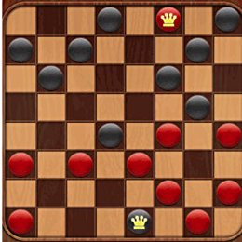
In general: The Machine-learning Problem Demystified
Machine-Learning
Machine performance improvement by experience
Machine Improves task T
W.r.t., performance measure P
Based on experience E
In checkers:
T ➔ Play Checkers;
P ➔ % of games won in world tournament;
E ➔ play against self;

Slide 70
Classification Applications in BI
Face recognition
Character recognition
Spam detection
Medical diagnosis: From symptoms to illnesses
Biometrics: Recognition/authentication using physical and/or behavioral characteristics: Face, iris, signature, etc
...

Slide 71
Exercise Corner!
Remember our data.europa.eu exercise?

Slide 72
Exercise Corner!
Remember our data.europa.eu exercise?
GOOD!

Slide 73
Exercise Corner!
Remember our data.europa.eu exercise?
GOOD!
Now, formulate, for that domain:
A supervised classification problem;
A supervised regression problem;
An unsupervised classification problem;
A reinforcement learning problem;

Slide 74
Exercise Corner!
Now, formulate, for that domain:
A supervised classification problem;
A supervised regression problem;
An unsupervised ML problem;
You have 20 mins!

Slide 75

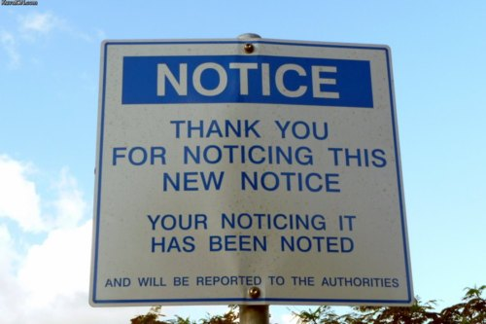
Bored yet?
10 min Break?
Coming up next... Classes of ML Problems

Slide 76
So... How do I do Machine Learning?
Natural lang.
vision
effectors
input
Knowledge
representation
learning
planning
reasoning

Slide 77
Step 1. Dataset
input
Mining Software Repositories,
Interviews, Surveys, Online Open Datasets,
Stream sources...
At least 3 issues:
Data cleanliness and quality;
Initial Classification of data (often manual!);
Classification, or inter-rater reliability;

Slide 78
Step 2. Representation
input
Knowledge
representation
At least 2 Issues:
Data formatting;
Data visualization;

Slide 79
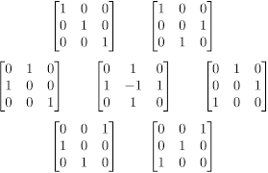
Step 2. Representation
input
Usually matrices!
Knowledge
representation
At least 3 Issues:
Data formatting;
Data visualization;
Data distribution;

Slide 80
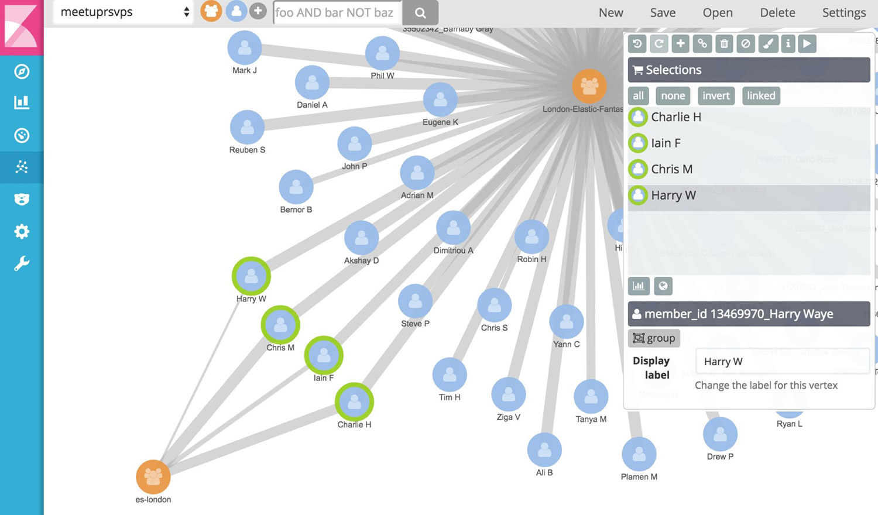
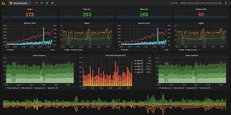


Step 2. Representation
input
It’s often *a lot* of data...
Need for specialised software!
Knowledge
representation
At least 3 Issues:
Data formatting;
Data visualization;
Data distribution;
Notes:
This is often called feature engineering

Slide 81
Step 3. Strategy Selection
Natural lang.
vision
input
Knowledge
representation
learning
planning
reasoning
The How!

Slide 82
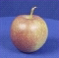
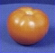
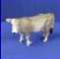
Strategy Selection: The machine learning framework
Apply a prediction function to a feature representation of the data to get the desired output:
f( ) = “apple”
f( ) = “tomato”
f( ) = “cow”
Slide credit: L. Lazebnik
Notes:
----- Meeting Notes (06/11/17 11:07) -----

Slide 83

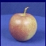
Strategy Selection: ML Design Phases
Training
Training Labels
Training data
Features
Training
Learned model
Testing
Test Image
Features
Learned model
Prediction
Slide credit: D. Hoiem and L. Lazebnik

Slide 84
The machine learning framework
y = f(x)
Training: given a training set of labeled examples {(x₁,y₁), …, (x_{N},y_{N})}, estimate the prediction function f by minimizing the prediction error E on the training set
Testing: apply f to a never before seen test example x and output the predicted value y = f(x)
output
prediction function
feature
Slide credit: L. Lazebnik

Slide 85
Splitting between Training and Testing
Two most common techniques:
Percentile sampling X/Y
Divide the dataset between X% to be used for training and Y% to be used for prediction where X>>Y (e.g., 70/30);
K-Folds cross-validation
Randomly divide dataset into K “folds” then randomly select 1 to be used as testing data; circularly select another 1, selecting all of them at least once, calculate average error rate of estimations;

Slide 86
Splitting between Training and Testing... How do you decide?
Two most common techniques:
Percentile sampling X/Y
Divide the dataset between X% to be used for training and Y% to be used for prediction where X>>Y (e.g., 70/30);
K-Folds cross-validation
Randomly divide dataset into K “folds” then randomly select 1 to be used as testing data; circularly select another 1, selecting all of them at least once, calculate average error rate of estimations;

Slide 87
Splitting between Training and Testing... How do you decide?
Two most common techniques:
Percentile sampling X/Y
Divide the dataset between X% to be used for training and Y% to be used for prediction where X>>Y (e.g., 70/30);
K-Folds cross-validation
Randomly divide dataset into K “folds” then randomly select 1 to be used as testing data; circularly select another 1, selecting all of them at least once, calculate average error rate of estimations;
BI: a LOT of Data!

Slide 88
Splitting between Training and Testing... How do you decide?
Two most common techniques:
Percentile sampling X/Y
Divide the dataset between X% to be used for training and Y% to be used for prediction where X>>Y (e.g., 70/30);
K-Folds cross-validation
Randomly divide dataset into K “folds” then randomly select 1 to be used as testing data; circularly select another 1, selecting all of them at least once, calculate average error rate of estimations;
a LOT of Data!
Not so much…

Slide 89
Splitting between Training and Testing... How do you decide?
Two most common techniques:
Percentile sampling X/Y
Divide the dataset between X% to be used for training and Y% to be used for prediction where X>>Y (e.g., 70/30);
K-Folds cross-validation
Randomly divide dataset into K “folds” then randomly select 1 to be used as testing data; circularly select another 1, selecting all of them at least once, calculate average error rate of estimations;
No silver-bullet

Slide 90
Splitting between Training and Testing... How do you decide?
Two most common techniques:
Percentile sampling X/Y
Divide the dataset between X% to be used for training and Y% to be used for prediction where X>>Y (e.g., 70/30);
K-Folds cross-validation
Randomly divide dataset into K “folds” then randomly select 1 to be used as testing data; circularly select another 1, selecting all of them at least once, calculate average error rate of estimations;
Depends on data!

Slide 91
Splitting between Training and Testing... How do you decide?
Two most common techniques:
Percentile sampling X/Y
Divide the dataset between X% to be used for training and Y% to be used for prediction where X>>Y (e.g., 70/30);
K-Folds cross-validation
Randomly divide dataset into K “folds” then randomly select 1 to be used as testing data; circularly select another 1, selecting all of them at least once, calculate average error rate of estimations;
Experiment!

Slide 92

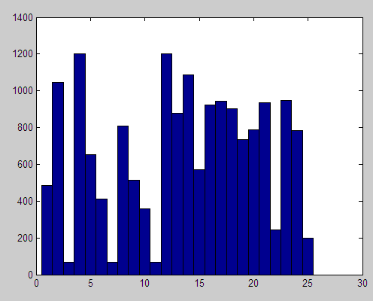

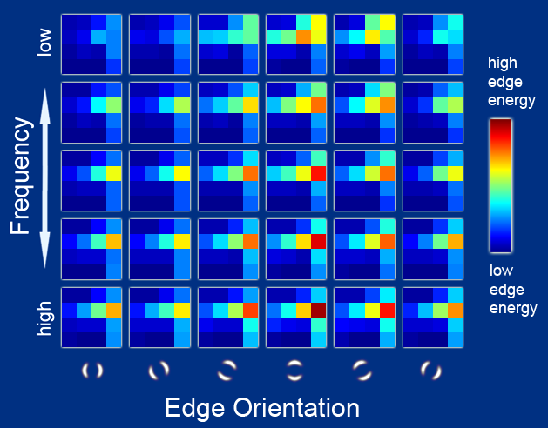
Step 4. Feature Engineering!
Raw pixels
Histograms
GIST descriptors
…
Slide credit: L. Lazebnik
Notes:
Given an input image, a GIST descriptor is computed byConvolve the image with 32 Gabor filters at 4 scales, 8 orientations, producing 32 feature maps of the same size of the input image.
Divide each feature map into 16 regions (by a 4x4 grid), and then average the feature values within each region.
Concatenate the 16 averaged values of all 32 feature maps, resulting in a 16x32=512 GIST descriptor.
Intuitively, GIST summarizes the gradient information (scales and orientations) for different parts of an image, which provides a rough description (the gist) of the scene.

Slide 93
What is feature selection?
Consider our training data as a matrix where each row is a vector and each column is a dimension
For example consider the matrix for the data x₁=(1, 10, 2), x₂=(2, 8, 0), and x₃=(1, 9, 1)
We call each dimension a feature or a column in our matrix

Slide 94
What is feature selection?
Useful for high-dimensional data such as genomic DNA and text documents.
Methods
Univariate (looks at each feature independently of others)
Pearson correlation coefficient
F-score
Chi-square
Signal to noise ratio
And more such as mutual information, relief
Multivariate (considers all features simultaneously)
Dimensionality reduction algorithms
Linear classifiers such as support vector machine
Recursive feature elimination
Principal Component Analysis (PCA)
Notes:
Principal component analysis (PCA) is a statistical procedure that uses an orthogonal transformation to convert a set of observations of possibly correlated variables^{[clarification needed]} into a set of values of linearly uncorrelated variables
This transformation is defined in such a way that the first principal component has the largest possible variance (that is, accounts for as much of the variability in the data as possible), and each succeeding component in turn has the highest variance possible under the constraint that it is orthogonal to the preceding components. The resulting vectors^{[clarification needed]} are an uncorrelated orthogonal basis set. PCA is sensitive to the relative scaling of the original variables. ariables called principal components.

Slide 95
What is feature selection?
Methods are used to rank features by importance
Ranking cut-off is determined by user
Uni-/Bi-variate methods measure some type of correlation between two random variables. We apply them to machine learning by setting one variable to be the label (y_{i}) and the other to be a fixed feature (x_{ij} for fixed j)

Slide 96
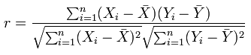
For example: Pearson correlation coefficient
Measures the correlation between two variables
Formulae:
Correlation(X,Y)= Covariance(X,Y)/σ_{X}σ_{Y}
Covariance(X,Y) = E((X-μ_{X})(Y-μ_{Y}))
Pearson correlation:
The correlation r is between -1 and 1. A value of 1 means perfect positive correlation and -1 in the other direction
Notes:
Pearson product-moment correlation coefficient =
covariance of the two variables divided by the product of their standard deviations.

Slide 97
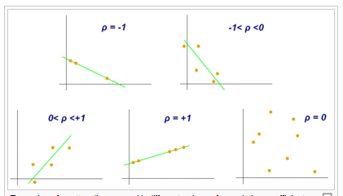
Pearson correlation coefficient*
*Thanks Wikipedia!

Slide 98
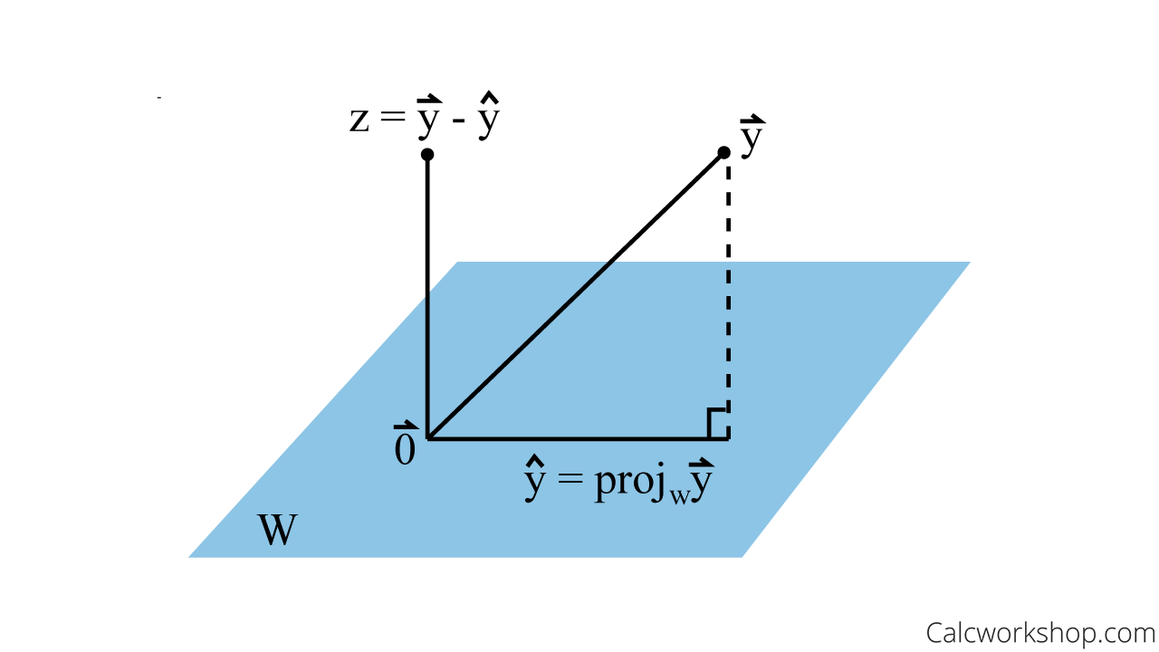
For Example… PCA
Notes:
Principal component analysis (PCA) is a statistical procedure that uses an orthogonal transformation to convert a set of observations of possibly correlated variables^{[clarification needed]} into a set of values of linearly uncorrelated variables
This transformation is defined in such a way that the first principal component has the largest possible variance (that is, accounts for as much of the variability in the data as possible), and each succeeding component in turn has the highest variance possible under the constraint that it is orthogonal to the preceding components. The resulting vectors^{[clarification needed]} are an uncorrelated orthogonal basis set. PCA is sensitive to the relative scaling of the original variables. ariables called principal components.

Slide 99
After feature engineering…
Apply Strategy
Train Model
Test Model
Improve Strategy
Satisfied?
Select ML Strategy
Starting Point
NO ☹
YES!

Slide 100
Back to BI and Data Analytics: Choosing a problem class and algorithms thereof
Accuracy (thorugh experimentation)
Training time (same as above)
Linear Separation (further down the line in the course!)
Number of algo’s parameters
Number of features

Slide 101
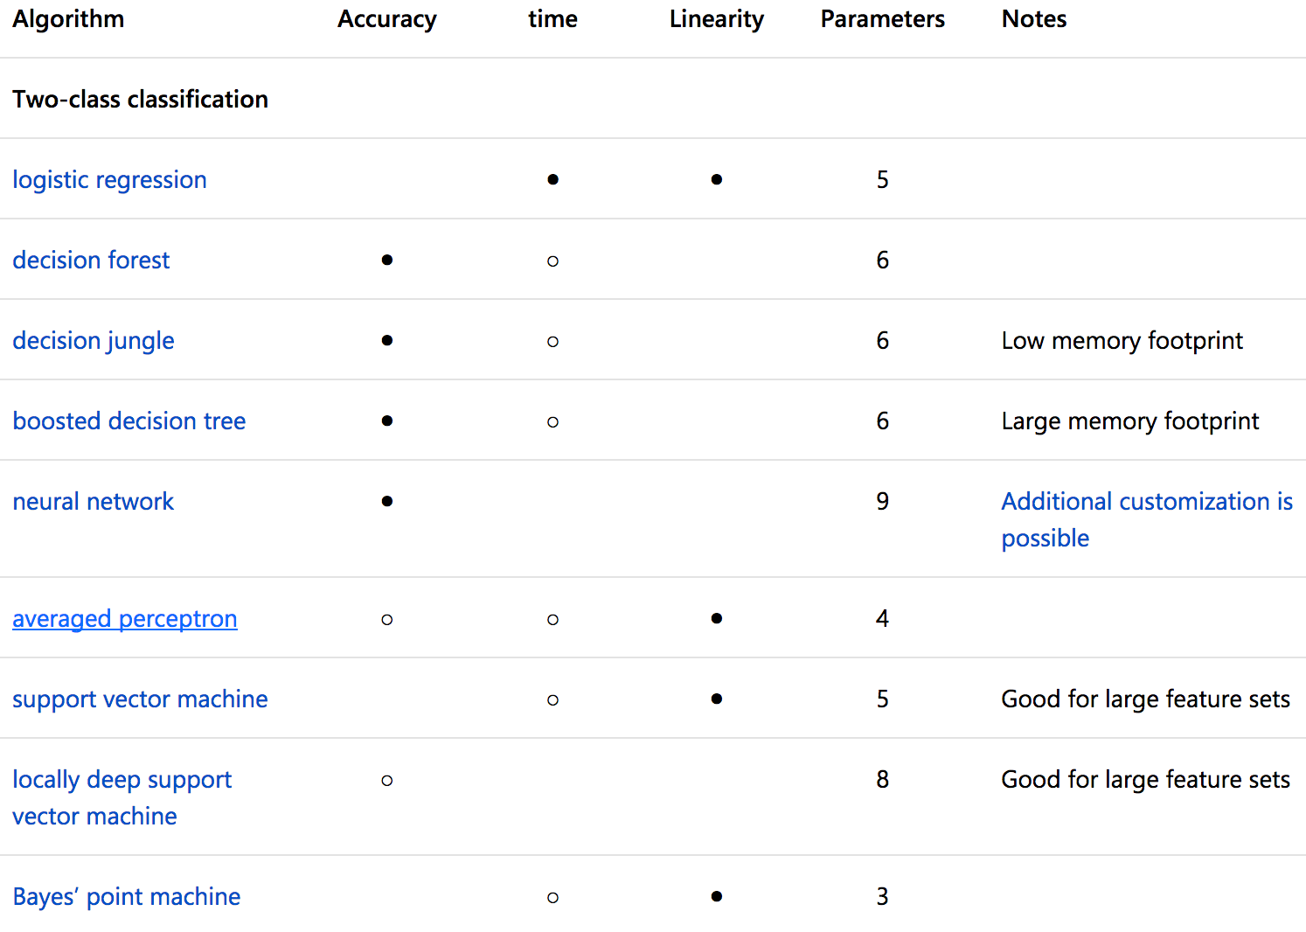
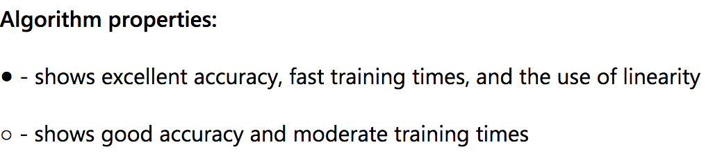

Slide 102
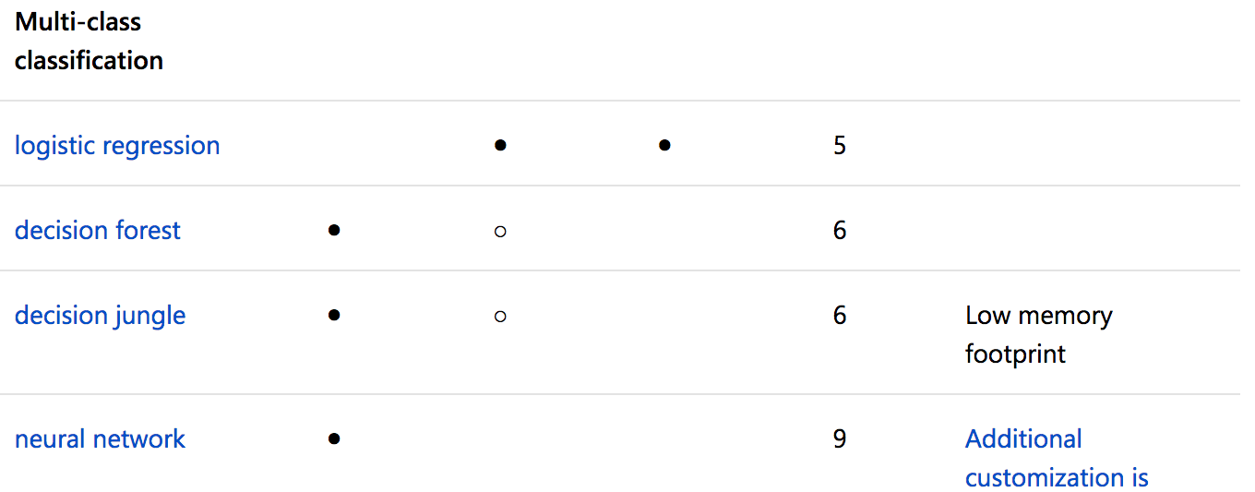
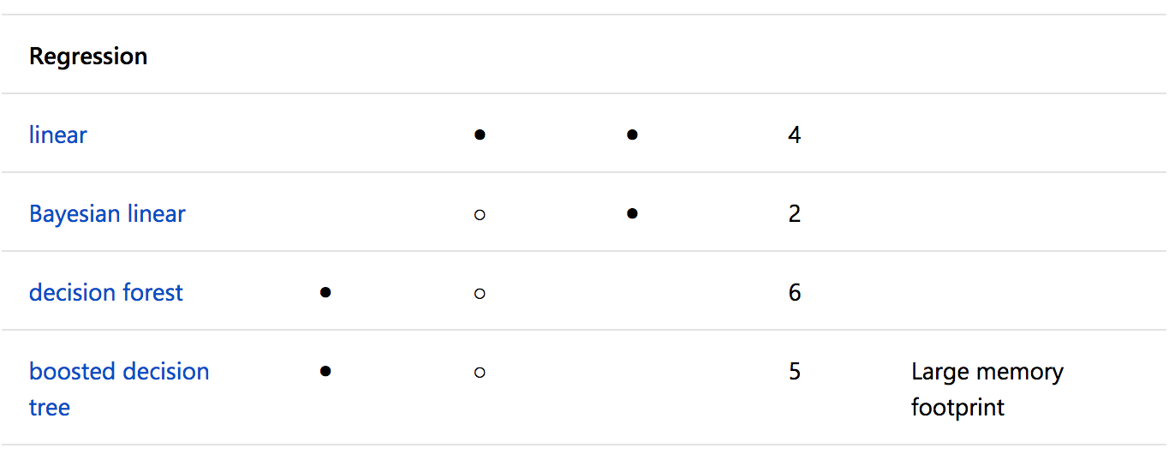
Notes:
https://docs.microsoft.com/en-us/azure/machine-learning/studio/algorithm-choice

Slide 103
Algorithm classes we will see examples of...
Decision-tree learning
Instance-based Learning
Ensemble techniques

Slide 104
Algorithm classes we will see examples of...
Decision-tree learning
Instance-based Learning
Ensemble techniques
Use a decision-tree to go from initial hypotheses to eventual conclusion (i.e., most generalisable hypothesis);
It can carry out classification in a discrete world (finite set of values) or continuous world (i.e., regression decision-tree);
Note: Requires (obviously) class-labelled examples

Slide 105
Algorithm classes we will see examples of...
Decision-tree learning
Instance-based Learning
Ensemble techniques
Do not perform explicit generalisation, compare with what was seen previously;
Algorithms focus on allowing construction of hypotheses stemming from previously seen input (training set);
Hypothesis complexity grows linearly with complexity of data;

Slide 106
Algorithm classes we will see examples of...
Decision-tree learning
Instance-based Learning
Ensemble techniques
Combination of the above, or different classes in the same type;
Enact smart combination (e.g., voting, weighted voting, etc.) for prediction;

Slide 107
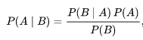
Algorithm classes you will see examples of in the modelling course!
Decision-tree learning
Instance-based Learning
Ensemble techniques
Bayesian Learning
Application of bayesian inference (generalised form) in action:
Essentially improve prediction as more information/iterations unfold;

Slide 108
Disruptive algorithm classes that we will NOT see & you should use plenty of
Artificial Neural Networks
Transformers

Slide 109
Disruptive algorithm classes that we WILL see & you should use plenty of
Artificial Neural Networks
Support-Vector Machines
Use geometrical tricks to reduce the amount of data from which to learn classification functions;
Use specific functions to make higher-order functionsin the data actually treatable;
Turn ML into a quadratic optimization programming problem;

Slide 110
What’s wrong with this approach of learning?
You’re essentially searching for a specific “h” which is generalisable “enough”
Depends heavily on how you construct H, the set of hypotheses
compare different approaches is key!
Heavily relies on the characteristics of the dataset

Slide 111
What’s wrong with this approach of learning?
You’re essentially searching for a specific “h” which is generalisable “enough”
Depends heavily on how you construct H, the set of hypotheses
compare different approaches is key!
Heavily relies on the characteristics of the dataset! Primarily,
<MOMENT of SUSPENSE>

Slide 112
What’s wrong with this approach of learning?
You’re essentially searching for a specific “h” which is generalisable “enough”
Depends heavily on how you construct H, the set of hypotheses
compare different approaches is key!
Heavily relies on the characteristics of the dataset! Primarily,
Dataset Balancing Problem!

Slide 113
Class Imbalance Problem
Problem
Class Imbalance: examples in training data belonging to one class heavily outnumber the examples in the other class.
Most learning systems assume the training sets to be balanced.
Result:
influence the performance achieved by existing learning systems.
The learning system may have difficulties to learn the concept related to the minority class.

Slide 114
ML with Imbalanced Data Sets… why is it difficult?
Domains
Medical record databases regarding a rare disease
Continuous fault-monitoring tasks
ML community seems to agree on the hypothesis that the class imbalance is the major hypothesis in inducing classifiers in imbalanced domains.

Slide 115
Why Learning from Imbalanced Data Sets might be difficult? (Con’t)
Spare cases from the minority class may confuse a classifier like k-nearest Neighbor (k-NN)

Slide 116
Motivation and Methods
Answer: The degree of data overlapping among the classes
Motivation:
Balance the training data
Remove noisy examples lying on the wrong side of the decision border
Methods:
Over-sampling method: Smote
Data cleaning methods: Tomek links, and Edited Nearest Neighbor Rule

Slide 117
Common Balancing Methods
Baseline Methods
Random over-sampling
Random under-sampling
Under-sampling Methods
Tomek links
Condensed Nearest Neighbor Rule
One-sided selection
CNN + Tomek links
Neighborhood Cleaning Rule
Over-sampling Methods
Smote
Combination of Over-sampling method with Under-sampling method
Smote + Tomek links
Smote + ENN

Slide 118
Common Balancing Methods
Baseline Methods
Random over-sampling
Random under-sampling
Under-sampling Methods
Tomek links
Condensed Nearest Neighbor Rule
One-sided selection
CNN + Tomek links
Neighborhood Cleaning Rule
Over-sampling Methods
SMOTE!
Combination of Over-sampling method with Under-sampling method
Smote + Tomek links
Smote + ENN

Slide 119
SMOTE: Synthetic Minority Over-sampling Technique [6]
To form new minority class examples by interpolating between several minority class examples that lie together.
in ``feature space'' rather than ``data space’’
Algorithm: For each minority class example, introduce synthetic examples along the line segments joining any/all of the k minority class nearest neighbors.
Note: Depending upon the amount of over-sampling required, neighbors from the k nearest neighbors are randomly chosen.
For example: if we are using 5 nearest neighbors, if the amount of over-sampling needed is 200%, only two neighbors from the five nearest neighbors are chosen and one sample is generated in the direction of each.

Slide 120
SMOTE: Synthetic Minority Over-sampling Technique
Synthetic samples are generated in the following way:
Take the difference between the feature vector (sample) under consideration and its nearest neighbor.
Multiply this difference by a random number between 0 and 1
Add it to the feature vector under consideration.
Consider a sample (6,4) and let (4,3) be its nearest neighbor.
(6,4) is the sample for which k-nearest neighbors are being identified
(4,3) is one of its k-nearest neighbors.
Let:
f1_1 = 6 f2_1 = 4 f2_1 - f1_1 = -2
f1_2 = 4 f2_2 = 3 f2_2 - f1_2 = -1
The new samples will be generated as
(f1',f2') = (6,4) + rand(0-1) * (-2,-1)
rand(0-1) generates a random number between 0 and 1.

Slide 121
SMOTE: A State-of-the-Art Resampling Approach
SMOTE stands for Synthetic Minority Oversampling Technique.
It is a technique designed by Chawla, Hall, & Kegelmeyer in 2002.
It combines Informed Oversampling of the minority class with Random Undersampling of the majority class.
SMOTE currently yields the best results as far as re-sampling and modifying the probabilistic estimate techniques go (Chawla, 2003).

Slide 122
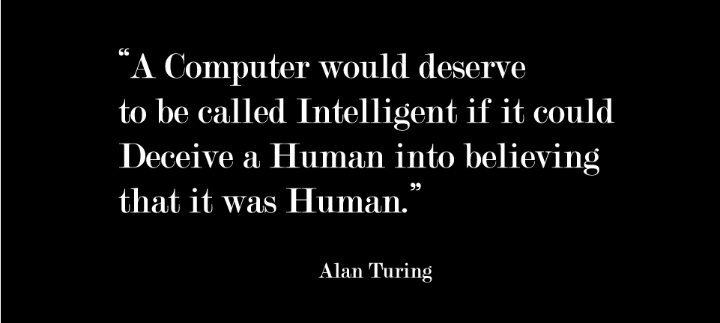
What is AI?
Machine Intelligence means Deception

Slide 123
So… in Summary
ML means learning from the past to predict the future;
Machines need to make less and less error in prediction (error is evaluated with statistical indexes, e.g., F-measure)
At least 3 classes of ML exist: (1) Supervised Learning; (2) Unsupervised Learning; (3) Reinforcement Learning;
They differ in types of data involved!
All three types of ML however essentially amount to approximating a function by «imitation»;
Typical issues: (1) choosing the right type of problem to solve; (2) presenting the right and appropriate data to the learning algo’s…
Notes:
What questions we will answer today?
What does ML mean and how does ML actually work?
What classes of ML exist? And how do they differ?
What does ML ultimately amount to achieving?

Slide 124

Questions?
Thanks!

Slide 125
Bibliography
Mitchell, T. Machine Learning. , McGraw-Hill (1997).
Alpaydin, Ethem. Introduction to Machine Learning. : The MIT Press, 2004.
Kubat, Miroslav. An Introduction to Machine Learning. : Springer, 2015.

Slide 126
References
Evaluation in Web mining Tutorial at ECML/PKDD 2004 Pisa, Italy; 20th September, 2004. Bettina Berendt, Myra Spiliopoulou, Ernestina Menasalvas
Towards a Methodology for Data mining Project Development : The Importance of Abstraction. Menasalvas, Millán, Gonzalez-Aranda, Segovia
Bettina Berendt, Andreas Hotho, Dunja Mladenic, Maarten van Someren, Myra Spiliopoulou, Gerd Stumme: Web Mining: From Web to Semantic Web, First European Web Mining Forum, EMWF 2003, Cavtat-Dubrovnik, Croatia, September 22, 2003, Revised Selected and Invited Papers Springer 2004
Myra Spiliopoulou, Carsten Pohle: Modelling and Incorporating Background Knowledge in the Web Mining Process. Pattern Detection and Discovery 2002: 154-169
www.crisp-dm.org
www.spss.com/clementine/cats.htm
www.sas.com/technologies/analytics/datamining/miner/semma.html
www.crmmethodology.com
www.emetrics.org/articles/whitepaper.html

Slide 127
Reading Materials
Text Books
T. Mitchell (1997). Machine Learning, McGraw-Hill Publishers, Chapt 1.
Lecture Notes
Course Slides
See slide 16 in notes, based on your project
Introduction to Machine Learning
Scientific Data-Mining Notes*
Notes:
Scientific Data-Mining Notes: https://pdfs.semanticscholar.org/cada/a94584a32f586b4af4bd5c5f95d8d89cf1dc.pdf

Slide 128
Technical Papers
Journals, e.g.,
Machine Learning, Kluwer Academic Publishers.
Journal of Machine Learning Research, MIT Press.
Conferences, e.g.,
International Conference on Machine Learning (ICML)
Neural Information Processing Systems (NIPS)

